Slide 1
Lecture 9 Query Refinement and Relevance Feedback
Reference:
[Gerald Benoit, Simmons College]
Notes:
This is the last part of web search, left content is advanced information retrieval model

Slide 2
Query Refinement
Query formulation
reformulated query
Search
Display number of hits
no hits
new query
Display retrieved information
Reformulate query
EXIT

Slide 3
Relevance Feedback: Motivation
Observations:
A Query only approximates an information need and exactly match the information need is difficult
Users often start with short queries (poor approximations)
People can improve queries after seeing relevant and non-relevant documents
by adding and removing terms
by reweighting terms
by adding structure (AND, OR, NOT, PHRASE, etc)
Question: Can a better query be created automatically by analyzing relevant and nonrelevant documents?

Slide 4
Types of Relevance Feedback
“Real” relevance feedback
System returns results
User provides some feedback
System returns different—better, we hope—results
“Assumed” relevance feedback
System gets results but does not return them
Uses returned results to “guess” what was probably meant
Modifies query without supervision
System returns enhanced—and we hope better—result list
Occurs in different models
Vector space is used most often (we’ll focus on it)
Language modeling
Excellent success with “assumed” relevance (relevance models)
Less obviously good results for “real” feedback

Slide 5
Theoretically Best Query
optimal query
o
x
x
x
o
o
x
x
x
x
x
x
x
o
x
x
x
o
x
o
x
x
x
x
x non-relevant documents
o relevant documents

Slide 6
Theoretically Best Query
For a specific query, Q, let:
D_{R} be the set of all relevant documents
D_{N-R} be the set of all non-relevant documents
sim (Q, D_{R}) be the mean similarity between query Q and
documents in D_{R}
sim (Q, D_{N-R}) be the mean similarity between query Q and
documents in D_{N-R}
The theoretically best query would maximize:
F = sim (Q, D_{R}) - sim (Q, D_{N-R})

Slide 7
Estimating the Best Query
In practice, D_{R} and D_{N-R} are not known. (The objective is to find them.)
However, the results of an initial query can be used to estimate sim (Q, D_{R}) and sim (Q, D_{N-R}).

Slide 8
Rocchio's Modified Query
Modified query vector
= Original query vector
+ Mean of relevant documents found by original query
- Mean of non-relevant documents found by original query

Slide 9
Query Modification
1
n₁
1
n₂
Σ
Σ
Q₁ = Q₀ + R_{i} - S_{i}
n₁
n₂
i =1
i =1
Q₀ = vector for the initial query
Q₁ = vector for the modified query
R_{i} = vector for relevant document i
S_{i} = vector for non-relevant document i
n₁ = number of relevant documents
n₂ = number of non-relevant documents
Rocchio 1971

Slide 10
Adjusting Parameters 1: Relevance Feedback
1
n₁
n₂
Σ
1
Σ
Q₁ = α Q₀ + β R_{i} - γ S_{i}
n₁
n₂
i =1
i =1
α, β and γ are weights that adjust the importance of the three vectors.
If γ = 0, the weights provide positive feedback, by emphasizing the relevant documents in the initial set.
If β = 0, the weights provide negative feedback, by reducing the emphasis on the non-relevant documents in the initial set.
Notes:
The motivation of parameter adjustment is to increase the flexibility of the model

Slide 11
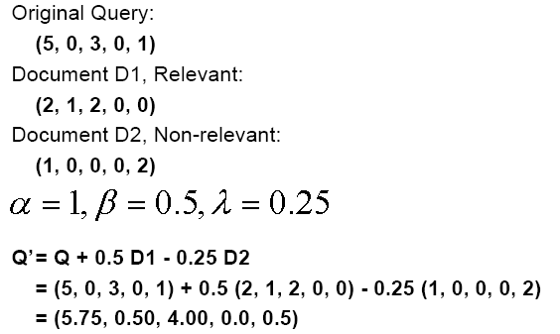
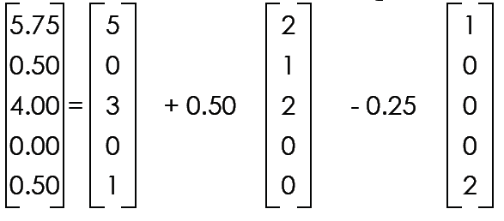
Relevance Feedback in the Vector Space: Example
Notes:
We don’t need to provide new query terms, in fact, under the VS model, we can just provide a new query vector.

Slide 12
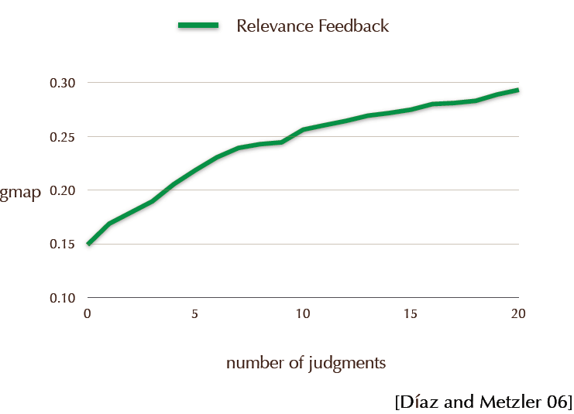
(geometric mean average precision)

Slide 13
Relevance Feedback: Clickthrough Data
Relevance feedback methods have suffered from the unwillingness of users to provide feedback.
Joachims and others have developed methods that use Clickthrough data from online searches.
Concept:
Suppose that a query delivers a set of hits to a user.
If a user skips a link a and clicks on a link b ranked lower,
then the user preference reflects rank(b) < rank(a).

Slide 14
Clickthrough Example
Ranking Presented to User:
1. Kernel Machines
http://svm.first.gmd.de/
2. Support Vector Machine
http://jbolivar.freeservers.com/
3. SVM-Light Support Vector Machine
http://ais.gmd.de/~thorsten/svm light/
4. An Introduction to Support Vector Machines
http://www.support-vector.net/
5. Support Vector Machine and Kernel ... References
http://svm.research.bell-labs.com/SVMrefs.html
Ranking: (3 < 2) and (4 < 2)
User clicks on 1, 3 and 4
Joachims

Slide 15
Relevance Feedback: Assumed
True relevance feedback is supervised
Feedback is done based on genuine user annotations
What happens if we try to guess what is relevant?
Assume many top ranked documents are relevant
Optionally find a collection of probably non-relevant documents
Modify query on that assumption
Re-run that new query and show results to user
What happens?
Pseudo-relevance feedback
Blind relevance feedback
Local feedback
…

Slide 16
Local Context Analysis (LCA)
[Xu and Croft, 1996]
Assumed relevance feedback
Major focus is on getting better terms for expansion
Finding terms to consider
Selection of terms
Weighting of selected terms

Slide 17
Finding candidate terms
Run query to retrieve passages
Similar to most “assumed” relevance work
Passage-retrieval
Minimizes spurious（欺骗性的） concepts that occur in lengthy documents
Uses 300-word passages
Select expansion concepts from retrieved set

Slide 18
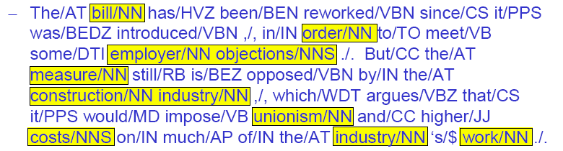
Selecting candidate terms
Parse document collection
Generate part of speech tagging
Select only noun phrases
Shown to be critical in most retrieval systems
Generally particularly useful for expansion
Could easily be extended if useful
Adjective-noun phrases, verbs, …
Note that tagging is automated, so makes mistakes!

Slide 19
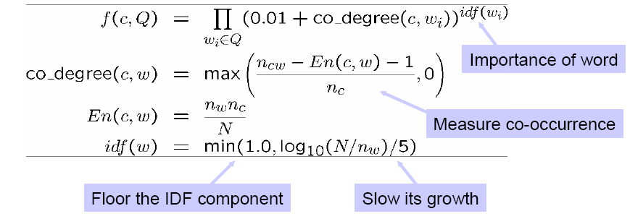
Weighting terms
Want “concepts” that occur near query words
The more query words they occur near, the better
Count co-occurrences in 300-word windows of text (passages)
To avoid coincidental co-occurrence in a large document
Uses the following ad-hoc function to weight concepts
Here N is the number of passages,
Notes:
*in the co_degree computing, the minus “1” in numerator part is to smooth the effect of low-frequency terms c and w that are by chances contained by the same passage. E.g., both df(c) and df(w) are 1 and the are by chance contained by the same passage, suppose that we get totally 100 passages, then if there is no “minus 1” term, the co_degree is nearly 1, it’s a very big values and may greatly bias the final ranking result since this co-occurrence is really not so significant (just occurred 1 time).

Slide 20
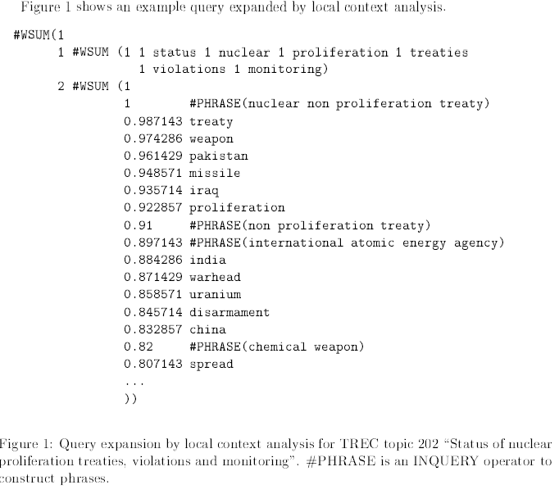
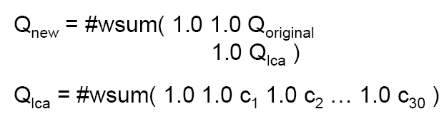
Using expanded query
Developed using Inquery
Incorporate using weighted sum
Weight original query and expansion query equally
Variations
Lower weight on each subsequent term
More important the more terms that are added
Weight original query equally with a single expansion concept
Only works when query is not very reliable
Notes:
For the INQUERY query language, #wsum (Ws W1 T1 ... Wn Tn) is a weighted combination of terms T1 to Tn. And the final belief score is scaled by Ws (in our case, it’s “1”), the weight associated with the #wsum itself. For more detail information, refer http://www.ushmm.org/helpdocs/inquerylang.htm.

Slide 21

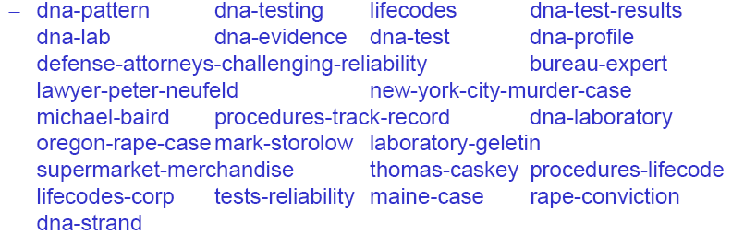
Example of expansion concepts
TREC query 213
As a result of DNA testing, are more defendants being absolved or convicted of crimes? (DNA测试是让更多的被告被赦免了还呢还是被宣告有罪了？）
Expansion concepts

Slide 22
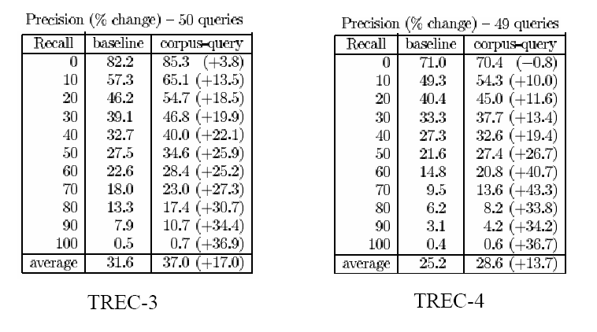
Does it work?
TREC-3 and TREC-4 ad-hoc queries
With and without LCA expansion

Slide 23
Summary
Relevance feedback
Real or assumed
Real relevance feedback
Usually improves effectiveness significantly
Not always stable with very few documents judged
Difficult to incorporate into a usable system
“Documents like this one” is a simple instance
Assumed relevance feedback
Also called “pseudo relevance feedback” or “local feedback”
Or “quasi-relevance feedback” or …
Rocchio-based approaches effective but unstable
LCA comparably effective (maybe better) but more stable
Relevance models provide formal framework

Slide 24
Learning to Rank (a quick glimpse)
--Improving search performance by large amount of examples
Ref: partially based on
Pandu Nayak and Prabhakar Raghavan, Stanford University

Slide 25
Learning to Rank
Assume:
distribution of queries P(Q)
distribution of target rankings for query P(R | Q)
Given:
collection D of documents
independent, identically distributed training sample (q_{i}, r_{i})
Design:
set of ranking functions F
loss function l(r_{a}, r_{b})
learning algorithm
Goal:
find f ∈ F that minimizes l(f (q), r )dP(q, r )
∫
Joachims
Notes:
This is for another 2-hours lesson

Slide 26
Machine learning for IR ranking
This “good idea” has been actively researched – and actively deployed by the major web search engines – in the last few years
Why didn’t it happen earlier?
Modern supervised ML has been around for about 20 years…
Naïve Bayes has been around for about 50 years…

Slide 27
Why weren’t early attempts very successful/influential?
Limited training data
Especially for real world use (as opposed to writing academic papers), it was very hard to gather test collection， queries and relevance judgments that are representative of real user needs and judgments on documents returned
This has changed, both in academia and industry
Poor machine learning techniques
Insufficient customization to IR problem
Not enough features for ML to show value
The Web provided impetus(动力) with constantly evolving spam

Slide 28
Why wasn’t ML much needed?
Traditional ranking functions in IR used a very small number of features, e.g.,
Term frequency
Inverse document frequency
Document length
It was easy to tune weighting coefficients by hand
And people did

Slide 29
Why is ML needed now
Modern systems – especially on the Web – use a great number of features:
Arbitrary useful features – not a single unified model
Log frequency of query word in anchor text?
Query word in color on page?
# of images on page?
# of (out) links on page?
PageRank of page?
URL length?
URL contains “~”?
Page edit recently?
Page length?
Major web search engines publicly state that they use “hundreds” of such features – and they keep changing

Slide 30
Simple example
Sec. 6.1.2
Consider the presence of query terms in the Title (T) and the Body (B) of a document
Boolean indicator (0/1) of whether the query term occurs in the Title (s_{T}) or Body (s_{B})
We’ll compute a score in [0,1] for each doc d and for each query q using a linear combination of s_{T} and s_{B}
Thus our scores are all 0, g, 1-g or 1.
g is a parameter to be learned from examples

Slide 31
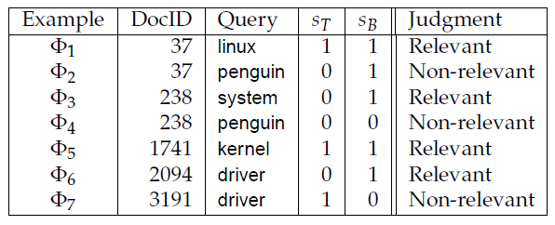
We are given examples
Sec. 6.1.2
Created by human judges
We quantize the human relevance judgments to be 1 or 0 respectively, for Relevant and Non-relevant
The scores we compute will be 0, g, 1-g or 1 – how do we tell how good our scoring function is?

Slide 32
Least square errors
Sec. 6.1.2
For each human-judged example, we compute its score:
Then we can compute a total error of the squared errors defined as:
We will pick g to minimize the total error.

Slide 33
Choosing g
Sec. 6.1.2
In our simple setting, all that matters is the number of examples* of each equivalence class
Define:
n01r = # examples with s_{T}=0, s_{B}=1, judgment = Rel
n01n = # examples with s_{T}=0, s_{B}=1, judgment = NonRel
n10r = # examples with s_{T}=1, s_{B}=0, judgment = Rel
n10n = # examples with s_{T}=1, s_{B}=0, judgment = NonRel
(and similarly n00r, n00n, n11r and n11n corresponding to the 4 other equivalence classes)
* this may not hold for other sets of features, e.g., the # characters in the query

Slide 34

Choosing g
The n01 examples with s_{T}=0, s_{B}=1 combined contribute a total least-squared error of
Similarly, add up the error contributions of the other 3 combinations of s_{T} and s_{B} for a total error of
Notes:
2g(no1r+n10n)-2(1-g)(n10r+n01n)=0

Slide 35

Choosing g is now elementary calculus
Differentiating the total error wrt g we get the optimal value for g to be

Slide 36
Generalizing this simple example
More (than 2) features
Non-Boolean features
What if the title contains some but not all query terms …
Categorical features (query terms occur in plain, boldface, italics, etc)
Scores are nonlinear combinations of features
Multilevel relevance judgments (Perfect, Good, Fair, Bad, etc)
Complex error functions
Not always a unique, easily computable setting of score parameters

Slide 37
Machine Learning: Algorithms
The choice of algorithms is a subject of active research.
Some effective methods include:
Naïve Bayes
Rocchio Algorithm
C4.5 Decision Tree [popular in OLAP]
Neural Networks [feed forward; back-propagation]
Genetic Algorithms [evolutionary]
k-Nearest Neighbors [image recognition]
Support Vector Machine
Deep Learning

Slide 38
Issues with Machine Learning Approaches
very unbalanced class distribution
number of relevant documents is very small compared to non-relevant documents
difficult to model non-relevant class
machine learning approaches do not scale well (NN for billions of documents?)

Slide 39
Homework 8

